Slide 1
Mid Term Assessment
Yatharth Deoly
Student ID: 224207854

Slide 2

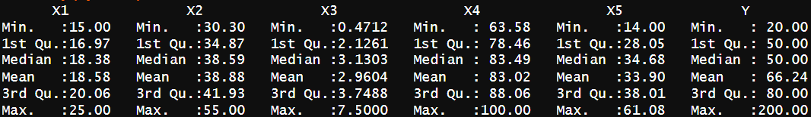
Understanding Energy Appliances Dataset
Dataset contains modified version of a subset of data used in Candanedo et al, 2017.
Dataset have 340 entries with 5 features and 1 variable of interest.
Dataset summarised:

Slide 3
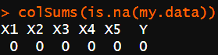
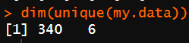
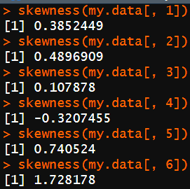
Preprocessing Dataset
Checking for missing values.
Checking for duplicates.
Checking skewness of data.

Slide 4
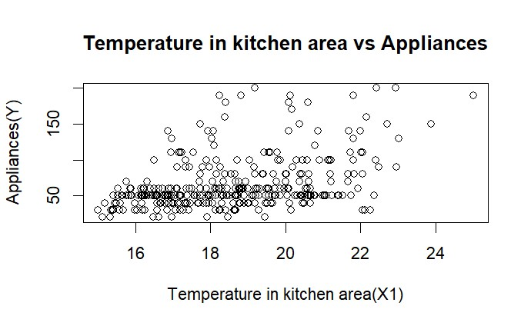
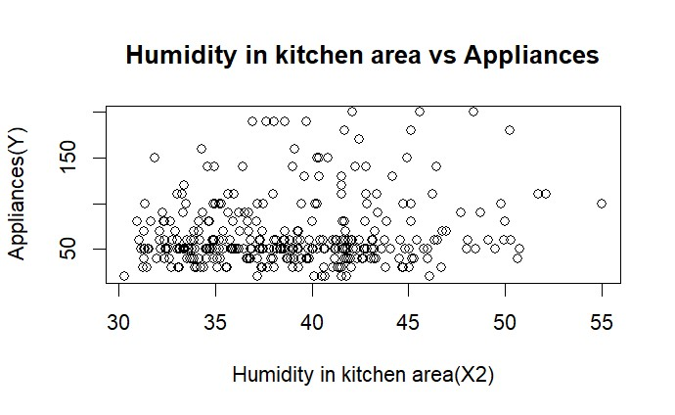
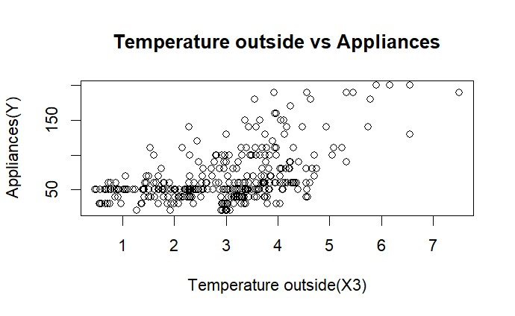
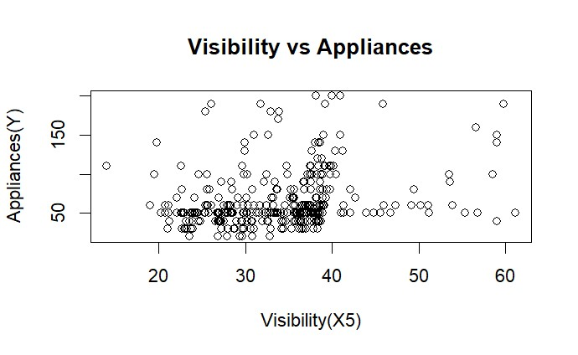
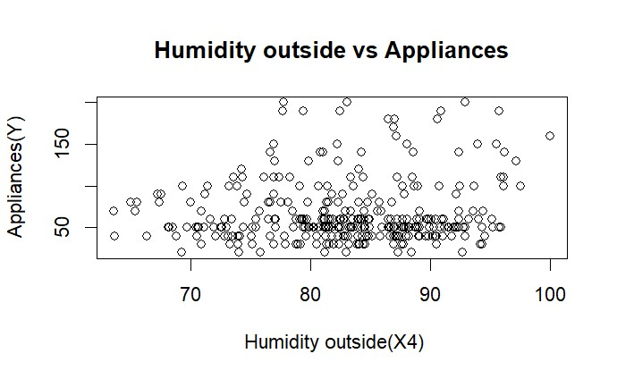
Scatter Plot

Slide 5
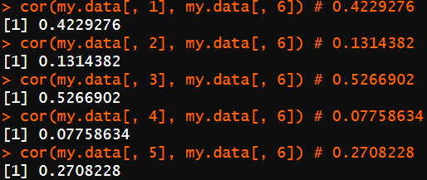
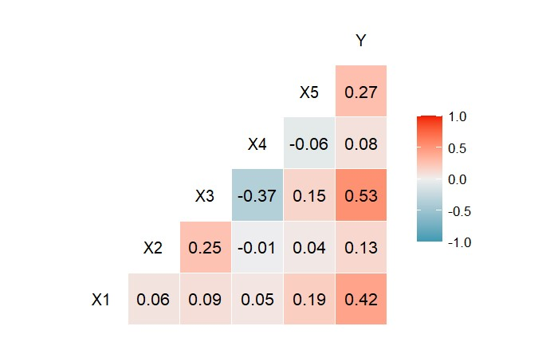
Correlation
Using cor() method, will understand relationship between each features(X1, X2, X3, X4, X5) with variable of interest(Y).
As per the details, except X4 all are valid for modelling purpose.

Slide 6
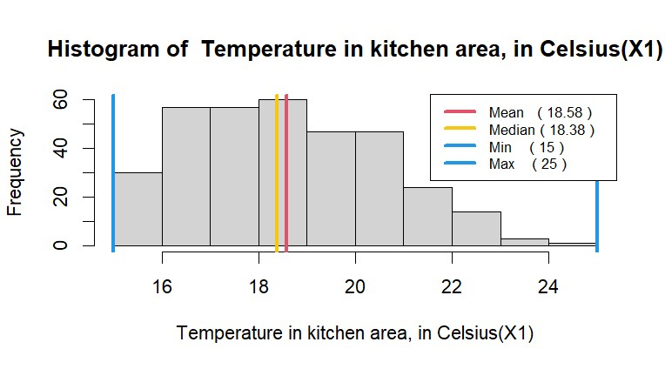
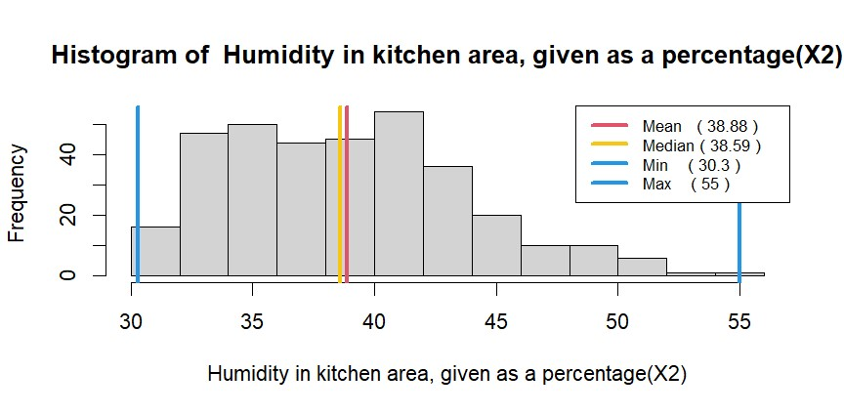
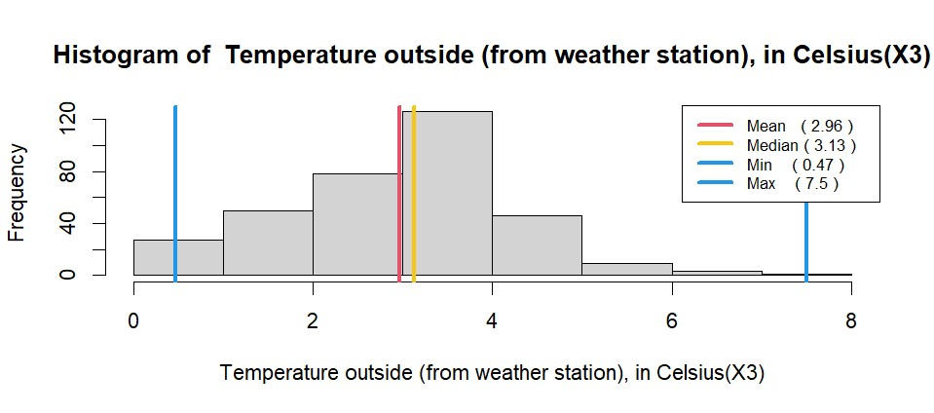
Histogram

Slide 7
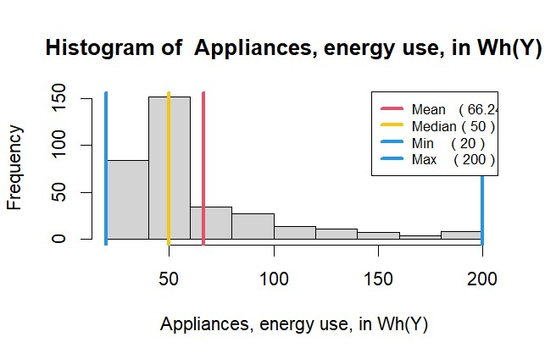
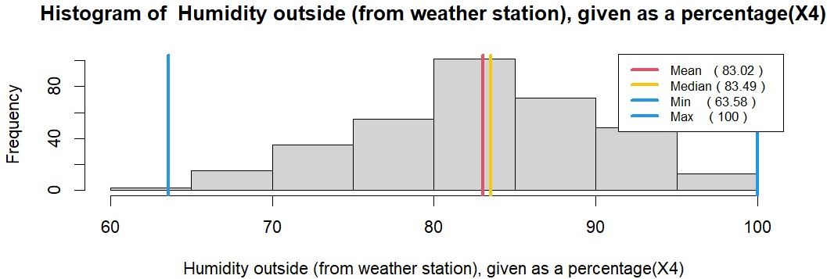
Histogram

Slide 8
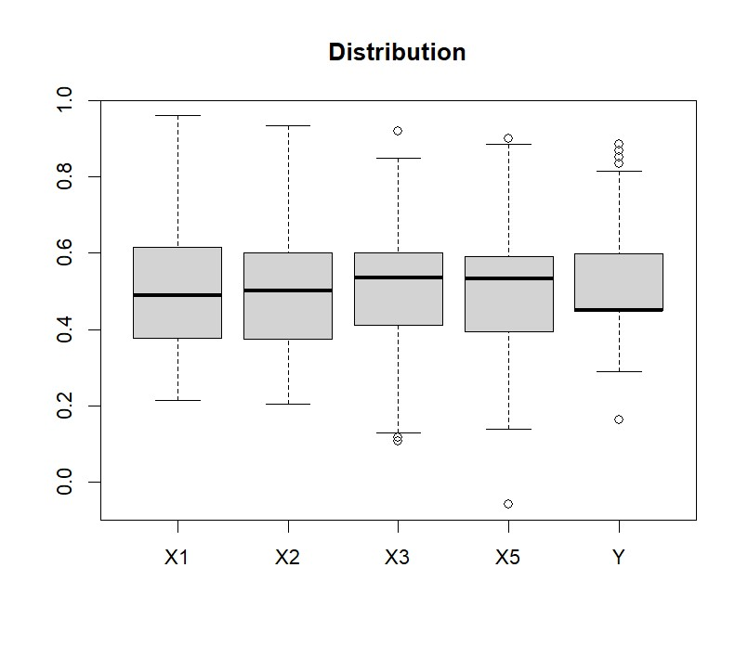
Outlier Description

Slide 9
Data Transformation
As we are considering only X1, X2, X3, X5 as features with Y as target.
Data transforming techniques:
Polynomial Transformation: This transformation has been applied with p as ½ on below params:
X1: Temperature in kitchen area, in Celsius
X3: Temperature outside (from weather station), in Celsius
Log Transformation: This transformation has been applied for below params:
X2: Humidity in kitchen area, given as a percentage
X5: Visibility (from weather station), in km
Y: Appliances, energy use, in Wh

Slide 10
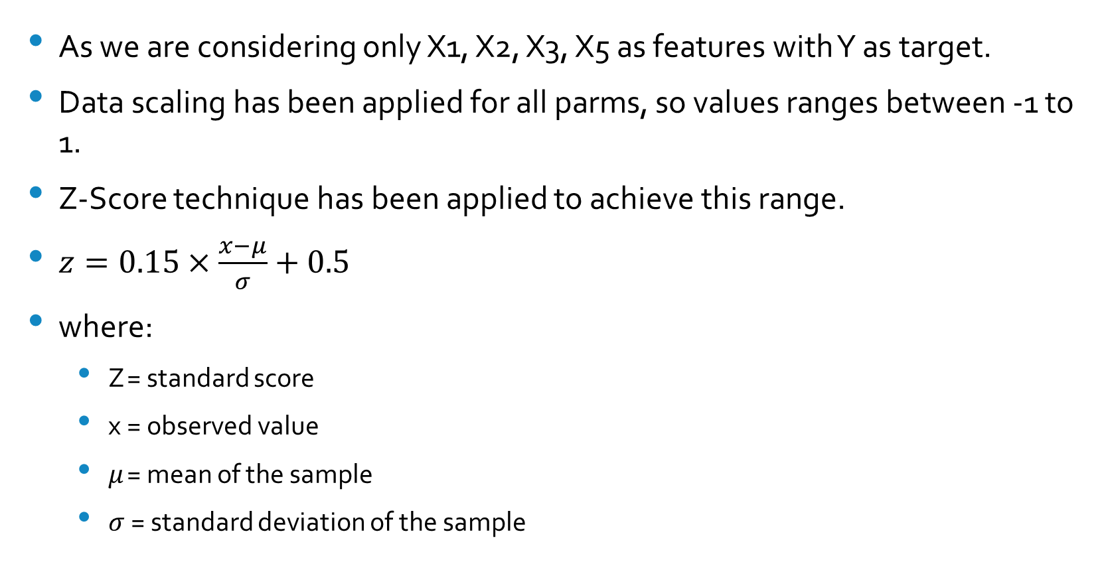
Data Scaling
As we are considering only X1, X2, X3, X5 as features with Y as target.
Data scaling has been applied for all parms, so values ranges between -1 to 1.
Z-Score technique has been applied to achieve this range.
$z=0.15×\frac{x−μ}{σ}+0.5$
where:
Z = standard score
x = observed value
$μ$ = mean of the sample
$σ$ = standard deviation of the sample

Slide 11
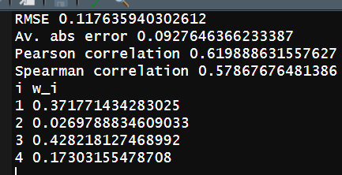
Aggregation Functions
Different aggregation functions has been used to learn the parameters.
Functions like:
Weighted arithmetic mean
Weighted power means with p = 0.5
Weighted power means with p = 2
Ordered weighted averaging
Choquet integral
From the above the aggregation functions, best result was acquired from Weighted arithmetic mean function, because of least RMSE and high correlation data.

Slide 12
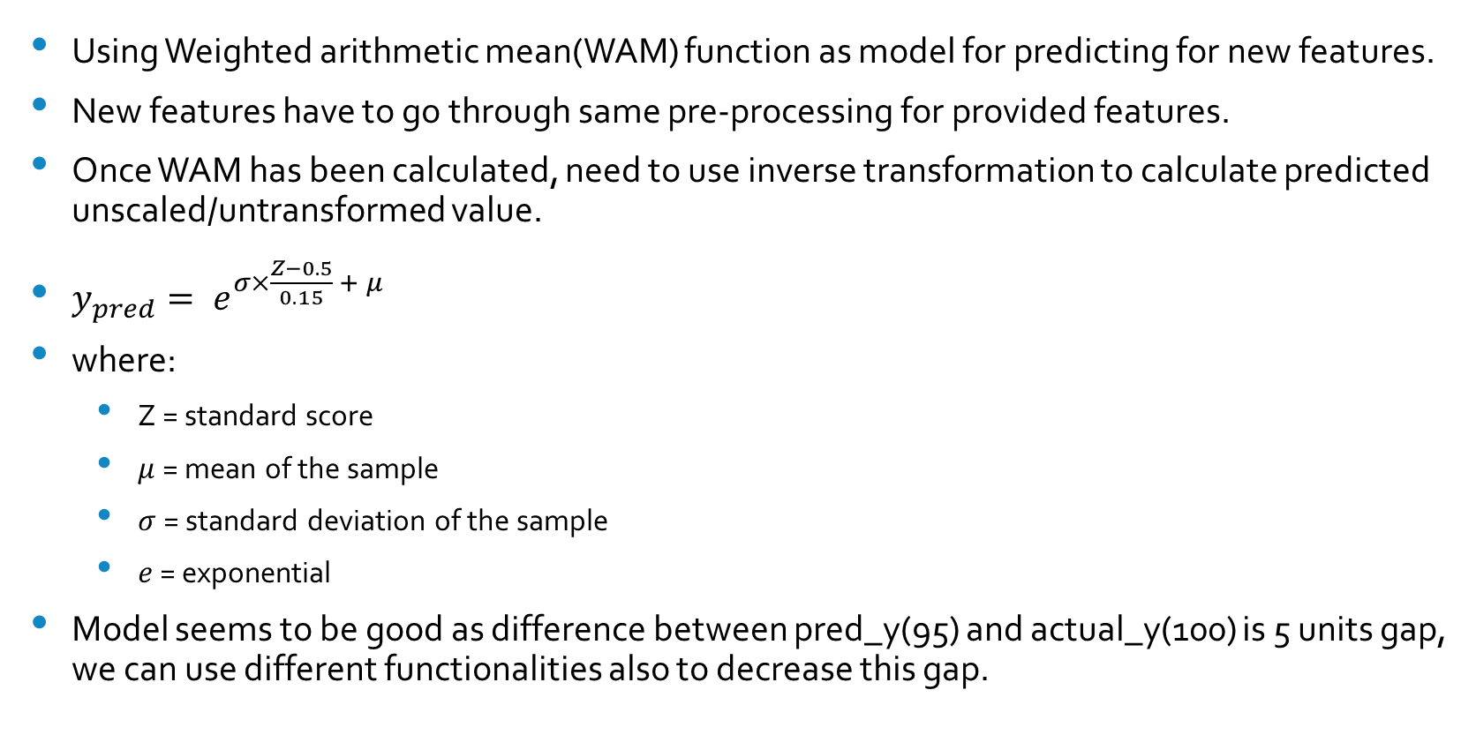
Prediction
Using Weighted arithmetic mean(WAM) function as model for predicting for new features.
New features have to go through same pre-processing for provided features.
Once WAM has been calculated, need to use inverse transformation to calculate predicted unscaled/untransformed value.
$y_{pred}= e^{σ×\frac{Z−0.5}{0.15} + μ}$
where:
Z = standard score
$μ$ = mean of the sample
$σ$ = standard deviation of the sample
$e$ = exponential
Model seems to be good as difference between pred_y(95) and actual_y(100) is 5 units gap, we can use different functionalities also to decrease this gap.

Slide 13
Limitation
As we have just taken 340 sample, which is limitation to our model to predict much better result.
Need to have more features for predicting Appliances.
From the given dataset we are able to predict energy use, which can be more accurate after some more deep dive(like feature selection, scaling, EDA and more).

Slide 14
What more can be done
Using different scaling/transforming mechanism(like min-max, negation, etc) to get much more better dataset for modelling.
Can use full dataset for modelling, as currently just subset has been used.
Different can be used for identifying and handling outliers.
Domain knowledge can lead for better feature checks and modelling.

